Slide 1

Understanding Long-term Care
Kathleen McGarry
Stony Brook University
University of California, Los Angeles
and NBER
Prepared for the KIPF-HAPI Conference, April 18-19, 2024, Honolulu, Hawaii

Slide 2
NBER iLTC Project
Draw on the knowledge / experience of 10 countries
Canada, Denmark, England, Germany, Italy, Japan, Netherlands, Singapore, Spain, United States
Canada: Kevin Milligan, Tammy Schirle
England: James Banks, Eric French, Jeremy McCauley
Germany: Axel Börsch-Supan, Johannes Geyer, Peter Haan, Elsa Perdix
Japan: Haruko Noguchi, Toshiaki Iizuka, Rong Fu
Netherland Eddy Van Doorslaer, Peter Bakx, Bram Wouterse
US: Jon Gruber, Kathleen McGarry
Try to learn something about what works and what doesn’t by comparing approaches

Slide 3

Introduction
Long-term care typically means help with Activities of Daily Living (ADLs)
Dressing, bathing, eating, toileting, getting in/out of bed, walking across a room
Less often it refers to help with higher level activities termed Instrumental Activities of Daily Living (IADLs)
Cleaning, managing money, preparing meals, shopping, taking medication, going to medical appointments, using the telephone

Slide 4
Differences in the Provision of Care
Public Insurance Coverage:
Existence of coverage
Extension of health insurance v. separate LTC insurance program
Means tested v. universal coverage
Coverage varies by age (e.g. Japan)
Paid through ltc insurance tax v. general revenue
Extent / inclusion of social supports programs
e.g. Medicaid expansions, US

Slide 5
Differences in the Provision of Care
Public Insurance Benefits
Institutional v. home care coverage
Self-directed care v. in-kind transfers
Benefits paid to family caregiver
Employment guarantees, pension coverage
Copayments
Vary with resources
Coverage of room and board in NH

Slide 6
Differences in the Provision of Care
Private Insurance Coverage:
Private insurance is rare, everywhere
Several governments trying to increase private insurance coverage
Private Coverage as Supplemental coverage
Japan
US has partnership plans (NYS Partnership Plan)

Slide 7
Differences in the Provision of Care
Structure of public programs leads to variation in how care is supplied
Underlying population characteristics
Age distribution
Health, morbidity
Family size, migration patterns
Social norms
Role / obligations of family
Expectation for assistance v. independence

Slide 8
Main Points
Most rapid growth among the oldest-old
Dramatic increases in need among oldest old
Leading to rapid growth in spending on LTC

Slide 9
Main Points
Countries vary substantially in fraction of GDP spent on LTC and in the use of institutional care and formal home care
Fraction receiving care in a NH ranges from 29 percent in Netherlands to 7 percent in Germany
Fraction receiving formal home care ranges from 23 percent in Spain to 63 percent in Japan
No apparent correlation between spending on formal home care and total LTC expenditures

Slide 10
Main Points
Women provide the majority of care
Gender difference is larger for formal care than informal care
Women are more likely to help with basic personal needs (ADLs) which may be less flexibly provided
Men are more likely to help with IADLs

Slide 11
Main Points
Public sector bears the lion share of costs
Even in countries with no national LTC insurance program
Strong positive correlation between fraction borne by public sector and LTC spending as a share of GDP

Slide 12
Main Points
Regardless of the system in place, informal care from family comprises the majority of care
Highlights the importance of including a measure of this care in statistics on the cost of long-term care
Such care is currently omitted
Proxies for this care have been incomplete

Slide 13
Main Points
Skilled caregivers (registered nurses) are fairly well compensated everywhere, but less skilled caregivers are poorly compensated
Skilled caregivers receive approximately the average wage in all countries
Less skilled caregivers receive roughly one-half the mean wage
Less than one-half in the US, three-quarters in Japan

Slide 14
Percent of Population 85+ 1990 and 2020
Notes:
International long-term care project

Slide 15
Percent of Population 85+ 1990, 2020, 2050
Notes:
International long-term care project

Slide 16
Percentage Point Increase in Population 85+ 1990-2050
Notes:
International long-term care project

Slide 17
Percentage Point Increase in Population 85+ 1990-2020, 2020-2050
Notes:
International long-term care project

Slide 18
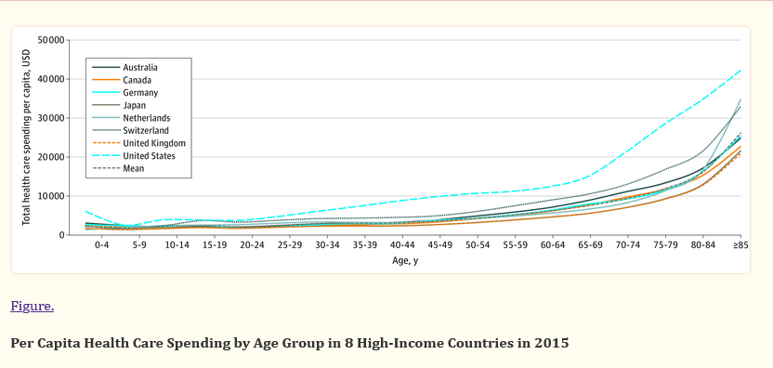
SOURCE: CMS
Notes:
OECE found 6 fold increase between those 55-59 and 85+
https://www.ncbi.nlm.nih.gov/pmc/articles/PMC7411536/
Papanicolas et al, JAMA, August 2020

Slide 19
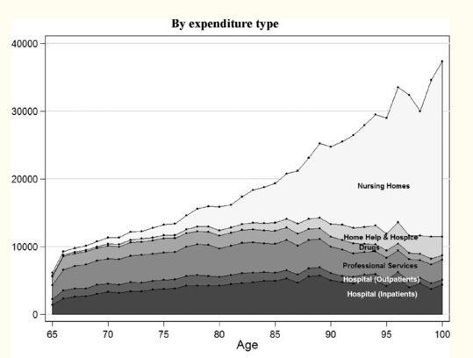
Medical Spending by age, US Data
Source: De Nardi, French, Jones, McCauley (Fiscal Studies, 2016), figure 3

Slide 20
Share of GDP Spent on Formal LTC, 2019
Notes:
International long-term care project

Slide 21
Percent formal LTC paid by public sector
Notes:
International long-term care project table 10

Slide 22

Struggle to Provide for the Future
Costs expected to continue to increase
Forecasted increases in costs from ‘10 to ‘50
Japan: 80-90%
Sweden: 25-50%
Tax rates have increased
Consider German Case:
1995: 1.7% of income
2002: Retired people pay full premium
2005: + 0.25% for childless adults
2008: 1.95%
2015: 2.35%
2017: 2.55%
Currently: 3.05% (3.40% for childless adults)

Slide 23
Share of 65+ receiving care in a Nursing Home
Notes:
International long-term care project

Slide 24
Share of 65+ receiving care with Formal Home Care
Notes:
International long-term care project

Slide 25
Shift away from Institutional Care to Home Care USA

Slide 26
Shift away from Institutional Care to Home Care Japan

Slide 27
Shift away from Institutional Care Netherlands

Slide 28
Total Formal Care Spending for Elderly by Type
 | Total Spending
Country | Nursing Home | Home Care | Home Care Share
Denmark | 4.1 | 1.7 | 0.29
England | 17 | 9 | 0.34
Germany | 41 | 40 | 0.49
Italy | 10 | 7 | 0.40
Japan | 31 | 55 | 0.63
Netherlands | 17 | 9 | 0.34
Spain | 1.3 | 0.4 | 0.23
US | 142 | 89 | 0.39

Slide 29
Spending per NH Resident
Notes:
International long-term care project table 8

Slide 30
NH Employment to Residents Ratio
Notes:
International long-term care project

Slide 31
Ratio of Caregiving Wage to Average Wage
 | Nursing Homes |  | Home Care
 | High Skilled | Lower Skilled | High Skilled | Lower Skilled
Denmark | 0.96 | 0.78 | 0.93 | 0.73
England | 0.94 | 0.50 | 0.96 | 0.52
Germany | 0.86 | 0.74 | 0.82 | 0.62
Japan | 1.13 | 0.79 | 1.13 | 0.78
Singapore | 1.01 | 0.57 | 1.03 | 0.54
US | 1.00 | 0.47 | 1.02 | 0.43
High skilled refers to registered nurses or equivalent, lower skilled refers to nursing assistant or home health care aides.

Slide 32
Share of 85+ with 2 or more ADL limitations
Notes:
International long-term care project

Slide 33
Issues with Formal Care
Quality issues
Both Institutional care and home care
Difficult to measure quality
Staffing
Shortages of workers
Little if any training
Waiting lists for home care

Slide 34
Substitution of Informal for Formal Care example China
“For officials, imposing the one-child policy also meant they had to challenge the deep-rooted traditional belief that children, sons in particular, provided a form of security in old age. To change this mind set, family planning offices plastered towns and villages with slogans saying that the state would take care of older Chinese.
But China’s population is aging rapidly. By 2040, nearly a third of its people will be over 60. The state will be hard pressed to support seniors, particularly those in rural areas, who get a fraction of the pensions received by urban salaried workers under the current program.
Now the official response has shifted dramatically, highlighting the importance of self-reliance and family support.”
--NY Times, March 8, 2024 “One Three Is Best: How China’s Family Planning Propaganda Has Changed” Isabelle Qian and Pablo Robles.
Notes:
https://www.nytimes.com/interactive/2024/03/09/world/asia/china-childbirth-propaganda.html

Slide 35
Share of 65+ receiving care relying exclusively on informal care
Notes:
International long-term care project

Slide 36
Share of 65+ with any formal or any informal home care
Notes:
International long-term care project

Slide 37
Fraction Caregivers Female
Source: Gruber and McGarry, 2022

Slide 38
Fraction Caregivers Female
Source: Gruber and McGarry, 2022

Slide 39
Implicit Value of Informal Care
Cost of informal care is ignored in official statistics
How do we value this care?
Commonly used:
(Mean wage of home care workers) x (hours of care)

Slide 40
Implicit Value of Informal Care
Alternative I:
(Caregiver’s hourly wage) x (hours of care)
Need to impute wage for those not working

Slide 41
Implicit Value of Informal Care
Alternative I:
(Caregiver’s hourly wage) x (hours of care)
Need to impute wage for those not working
Difficulties:
Observed wage may not be the wage absent care
Switch to part-time work
Switch to more flexible job
Less on the job investment → less wage growth
Not everyone would be working absent the need to provide care

Slide 42
Implicit Value of Informal Care
Alternative II:
(Imputed prob working) x (imputed wage for all workers) x (hours of care)

Slide 43
Implicit Value of Informal Care
Alternative II:
(Imputed prob working) x (imputed wage for all workers) x (hours of care)
Difficulties:
Values lost leisure time at zero
Should we include such a cost?
There is an opportunity cost that is ignored
Foregone leisure, childcare, household production, investment in human capital, health capital
How do we value leisure?

Slide 44
Implicit Value of Informal Care
Alternative III:
(Imputed prob working) x (imputed wage) x (hours of Care) + (1 – imputed prob working) x (median wage of home care workers) x (hours of care)

Slide 45
Implicit Value of Informal Care
Issues
Treats all types of care as equally valuable
Bathing, toileting, dressing, help with medication…
Treats all types of caregivers the same
Spouse, children, coresident
Measuring hours of care is difficult
24-hour care, multitasking
Similar to issue of measuring care for children

Slide 46
Ratio of Informal to Formal Care Expenditures
Country | Informal / Formal
Denmark | 0.53
England | 1.56
Germany | 0.70
Italy | 2.03
Japan | 0.75
Netherlands | 0.52
Singapore | 0.53
Spain | 1.21
US | 0.65
Restricted to formal care for the elderly

Slide 47
Share of GDP Spent on Informal LTC 65+, 2019
Notes:
International long-term care project

Slide 48
Comparative Cost of Care (Fraction of GDP)

Slide 49
Cost of Caregiving
Tend to find:
Some employment effect on extensive margin:
Caregiving is associated with a lower probability of working
Mixed results on intensive margin
Little evidence of fewer hours conditional on working
Negative long-term effects
Lower wage growth
Lower probability of employment
Lower assets in retirement
Notes:
https://www.ncbi.nlm.nih.gov/pmc/articles/PMC6850889/pdf/gny137.pdf

Slide 50
Health Costs of Informal Care
Mixed results for physical health
Consistently negative results of self-reported health
Less clear for various physical measures
Mortality, strokes,…
Consistently negative effects on emotional health
Depression, reported stress
Review Bon, Bakx, Schut and van Doorslaer, 2018

Slide 51
Health Costs of Informal Care
Emotional Health
Intrinsic rewards to caregiving
Pinquart and Sorensen, 2004
Effects on non-caregivers (non-caregiving children)
Amirkhanyan and Wolf, 2006

Slide 52
Compensating Informal Caregivers
Funds directly to recipient or to caregiver
“Caregivers allowance,” “Consumer Directed Care”
Tax credits, dependents, tax deductions for costs,..
Pension credits
Positive or negative?
Provides income to offset lost wages / cover costs
Time out of the labor market at lower wage
Loss of human capital
Difficulty finding a job when returning to work

Slide 53
Outcomes
Skira (2015, IER)
Models these dynamics
Time off from work, investment in human capital, difficulty in finding a job upon return, lower wages
Difficulty in varying hours as desired
Estimates effect of two years of caregiving
Immediate direct costs (foregone wages) of $21,220
Lifetime wage loss $51,780
Lifetime welfare loss of $164,725
Notes:
https://www.ncbi.nlm.nih.gov/pmc/articles/PMC6850889/pdf/gny137.pdf

Slide 54
Outcomes
Simulates policy changes:
Two years of unpaid leave (can return to job at the end of the caregiving spell)
→ Increase care and total work
Two years of paid leave
→ Increase care and total work
Two years’ worth of a caregiver allowance (reminiscent of what is available)
→ Increase care and decrease work
Notes:
https://www.ncbi.nlm.nih.gov/pmc/articles/PMC6850889/pdf/gny137.pdf

Slide 55
The Future of Long-Term Care
Declining Fertility
Increasing Longevity
Greater labor force participation for women
Greater education levels for women
Migration
Changes in disease specific mortality

Slide 56
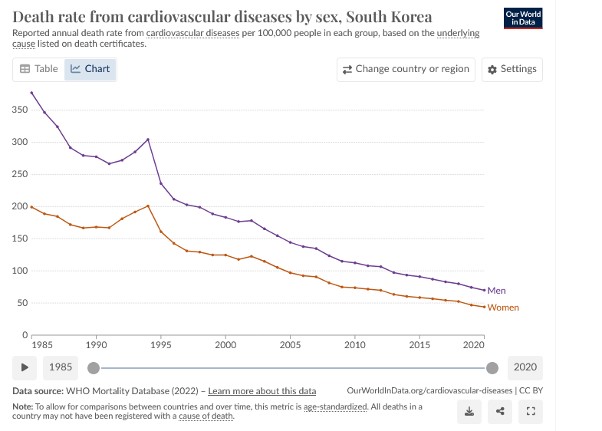
Notes:
https://ourworldindata.org/cardiovascular-diseases

Slide 57
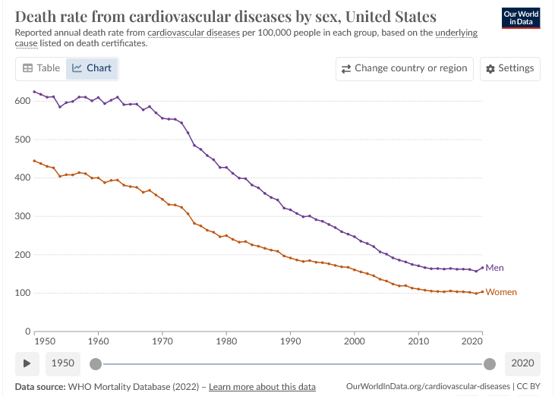

Slide 58
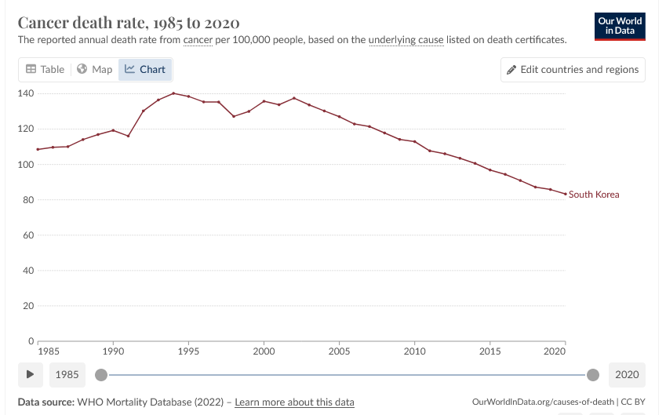

Slide 59
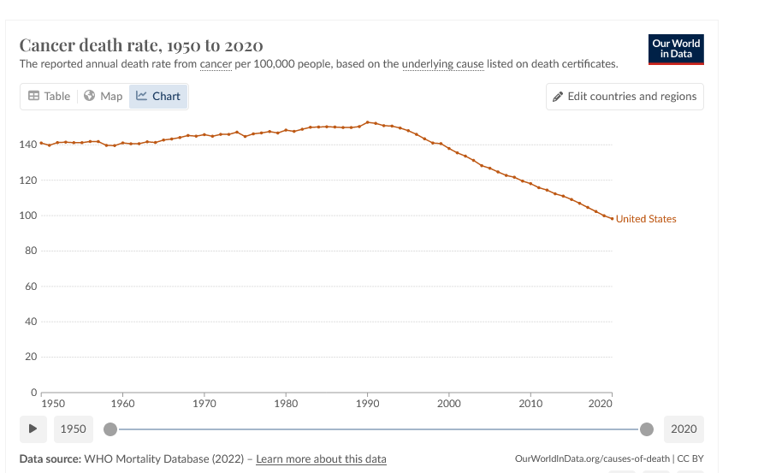

Slide 60
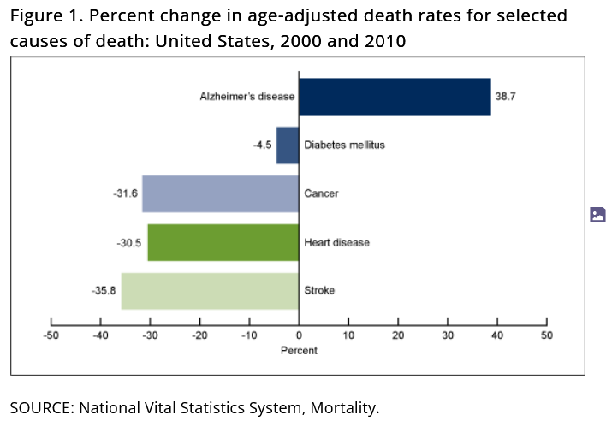
NCHS, 2013

Slide 61
Second Round of iLTC Project
Meeting in June
Nine countries
Examine differences in the care of those with cognitive impairments
Differences across countries
Differences relative to physical impairments

Slide 62
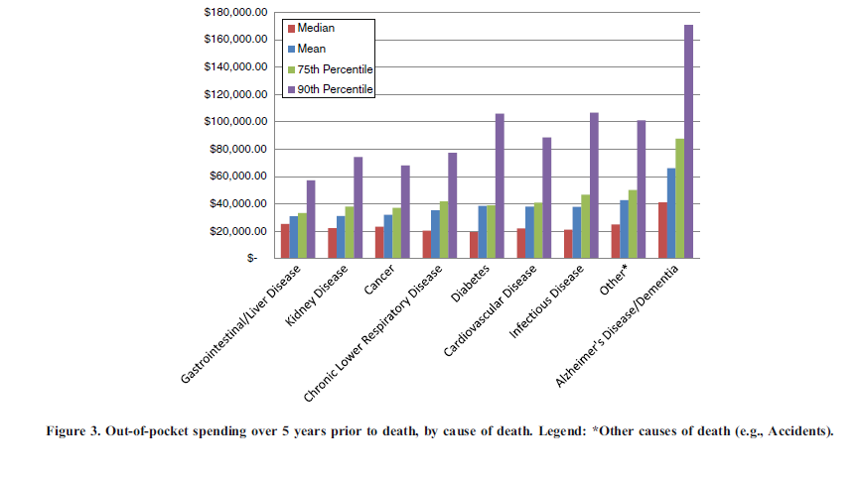
Cost of Formal Care
SOURCE: Kelley, McGarry et al. 212

Slide 63
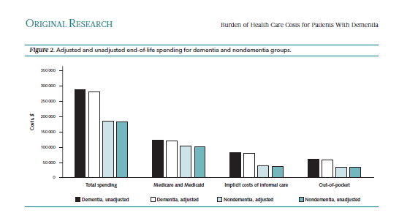
Kelley, McGarry, Gorges, Skinner, Annals, 2015

Slide 64
Solutions
Continued expanded use of home care
Crowding out family care
Expanded use of private insurance
Two classes of care

Slide 65
Technology
Remote medical care
Medical reminders,
Virtual office visits
Wearable sensors
Movement, Sleep, Falls
Smart homes / Monitoring
Motion detectors (doorways, floors)
Cameras
Stove monitors
Voice-based personal assistants

Slide 66
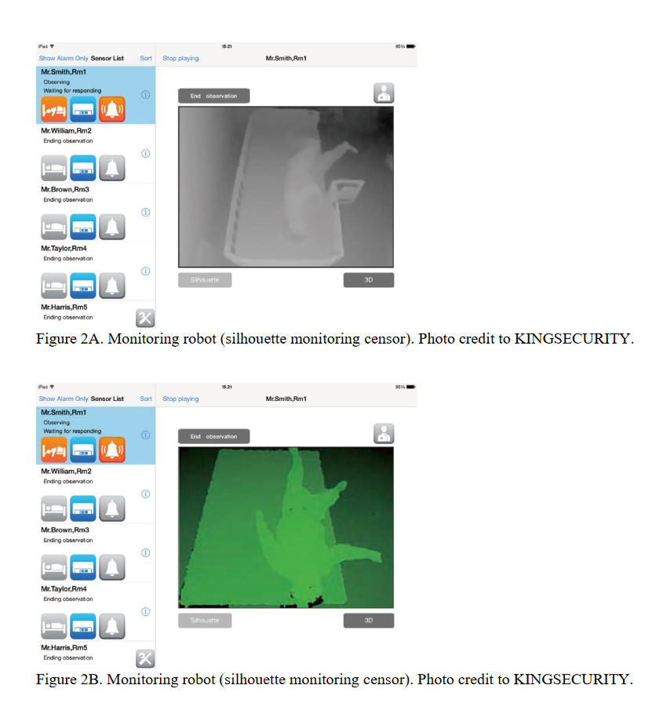

Slide 67
Solutions
Robots as staff
Delivery of food to dining rooms, clearing tables, bringing medication, transference, night monitoring
Eggleston, Lee and Iizuka (2021)
Reduce wages (22% for nurses, night wages)
Increases for management
Increases use of non-regular staff
Reduces turn-over

Slide 68
Solutions – Technology
Many ethical concerns
Deceiving patients
Lack of human contact
Dehumanization
Loneliness and Isolation already a problem

Slide 69
Thank you

Slide 70
Ratio of Formal LTC Expenditures to GDP
 | Share GDP |  | Increase
 | 2000 | 2019 | Amount | Percent
Canada | 1.3 | 2.1 | 0.8 | 61%
Denmark | 1.9 | 2.1 | 0.2 | 11
Germany | 1.4 | 2.2 | 0.8 | 55
Japan | 0.7 | 2.1 | 1.4 | 212
Netherlands | 2.7 | 4.1 | 1.4 | 50
United States | 1.1 | 1.3 | 0.2 | 17
Mean | 1.4 | 2.1 | 0.7 | 60
Includes all formal LTC expenditures regardless of age

Slide 71
Introduction
Ms. Washington found herself performing high-level nursing tasks, like administering antibiotics three times a day through a PICC line — a thin tube that leads from veins in the arm to the veins near the heart. “My hands were shaking,” she said as she remembered apprehensively pushing in the drugs for the first time and feeling the weight of keeping her husband alive.
Notes:
One study predicts 75 percent increase in nursing home care by 2030
https://www.mcknights.com/marketplace/marketplace-experts/how-consolidation-and-change-challenge-ltc/

Slide 72
Introduction
I don't regret it for a second. My mother would not have lived nearly as long and would have had a much worse quality of life if I hadn't. And that time together is incredibly precious to me.
Notes:
One study predicts 75 percent increase in nursing home care by 2030
https://www.mcknights.com/marketplace/marketplace-experts/how-consolidation-and-change-challenge-ltc/

Slide 73
Introduction
Being a caregiver affected my stress levels thus my sleep and mood, affected my finances, affected my hospital job… I would do it all again as my parents were loving and generous people.
Notes:
One study predicts 75 percent increase in nursing home care by 2030
https://www.mcknights.com/marketplace/marketplace-experts/how-consolidation-and-change-challenge-ltc/

Slide 74
Introduction
I was lucky that my employer allowed me to have a reduction in hours and duties. But that came with an appropriate pay cut and many lost professional opportunities. After you say no for a while and stop going to networking opportunities, people stop asking.
Notes:
One study predicts 75 percent increase in nursing home care by 2030
https://www.mcknights.com/marketplace/marketplace-experts/how-consolidation-and-change-challenge-ltc/

Slide 75
Percent of Elderly in Nursing Homes
Source: Gruber and McGarry, 2022

Slide 76
Spending by source and type of care
Care Type | Source | Canada | Denmark | Eng | Germany | Italy | Japan | Netherlnd | Spain | US
Nursing Home | Public | 0.9% | 1.1% | 0.4% | 0.5% | 0.3% | 0.5% | 1.6% | 0.3% | 0.5%
 | Private | 0.4% | 0.1% | 0.2% | 0.4% | 0.1% | 0.1% | 0.2% | 0.3% | 0.2%
 | All | 1.2% | 1.2% | 0.6% | 0.9% | 0.4% | 0.6% | 1.8% | 0.6% | 0.7%
Home Care | Public | 0.4% | 0.4% | 0.3% | 0.7% | 0.2% | 1.0% | 0.9% | 0.1% | 0.3%
 | Private | 0.2% | 0.1% | <0.1% | 0.2% | <0.1% | 0.1% | <0.1% | <0.1% | 0.1%
 | All | 0.6% | 0.5% | 0.3% | 0.9% | 0.3% | 1.0% | 0.9% | 0.2% | 0.4%
Informal Care | Private | 1.3% | 0.9% | 1.4% | 1.2% | 1.4% | 1.2% | 1.4% | 0.9% | 0.7%
Total | Public | 1.3% | 1.5% | 0.6% | 1.3% | 0.5% | 1.5% | 2.5% | 0.5% | 0.8%
 | Private | 1.8% | 1.1% | 1.7% | 1.8% | 1.5% | 1.3% | 1.6% | 1.2% | 1.0%
 | All | 3.1% | 2.7% | 2.3% | 3.0% | 2.1% | 2.8% | 4.1% | 1.7% | 1.8%
Age-Adjusted Total |  | 3.3% | 2.7% | 2.4% | 2.9% | 1.7% | 2.0% | 4.2% | 1.8% | 2.1%

Slide 77
Country | Eligibility | Formal Setting |  | Cost Burden |  | Provision
 |  | Nursing Home | Home Care | Public | Private | Formal | Informal
Canada | Means | 1.2% | 0.6% | 1.3% | 1.8% | 1.8% | 1.3%
Denmark | Universal | 1.2% | 0.5% | 1.5% | 1.1% | 1.8% | 0.9%
England | Means | 0.6% | 0.3% | 0.6% | 1.7% | 0.9% | 1.4%
Germany | Universal | 0.9% | 0.9% | 1.3% | 1.8% | 1.8% | 1.2%
Italy | Means | 0.4% | 0.3% | 0.5% | 1.5% | 0.7% | 1.4%
Japan | Universal | 0.6% | 1.0% | 1.5% | 1.3% | 1.6% | 1.2%
Netherlnd | Universal | 1.8% | 0.9% | 2.5% | 1.6% | 2.7% | 1.4%
Singapore | Universal | 0.2% | 0.2% | 0.1% | 0.4% | 0.3% | 0.2%
Spain | Universal | 0.6% | 0.2% | 0.5% | 1.2% | 0.8% | 0.9%
US | Means | 0.7% | 0.4% | 0.8% | 1.0% | 1.1% | 0.7%

Slide 78
NH Residents per 65+ Population
Notes:
International long-term care project

